Slide 1
Parkinson’s disease Prediction using Machine Learning and Data Analytics
Made by: Iktaj Singh Bhinder
Email: iktaj2000@gmail.com

Slide 2

Outline of Project
Introduction to Project
Hardware and software specification
Methodology and framework
Creation of prediction Model using Adaboost
Problem Formulation
Objectives of the work
Project Model Flow
Attribute Tree Hierarchy
Results and Outputs
Conclusion
Future Scope
References

Slide 3
Introduction to Project
Parkinson’s Disease Prediction Software is a desktop based GUI application that is predicting the chance of a patient having Parkinson’s disease, which is a type of neurological disorder that affects small regions in the brain that control movement, posture and balance.
The software is based on Predictive Analytics and Machine learning which creates a prediction model that is capable to predict the chance of a patient having Parkinson’s .
This software uses the UCI machine Learning repository’s Parkinson dataset that has 23 attributes and 197 instances.
Our predictive model is using ADABOOST classifier which is a short for Adaptive Boosting. It is a Boosting technique that is used as an Ensemble Method in Machine Learning which helps to predict status of patient’s disease.
During modeling we take training dataset for training the model with different parameters so as to make an optimal prediction model with good accuracy.

Slide 4
In this software, the user has to upload their dataset that is compatible with the UCI dataset attributes for the Prediction model to predict the result.
Once the Data Set is uploaded, then our model predicts the result and it will show what is the percentage chance of having a patient to have Parkinson’s disease or not.
PDPS software is embedded with Modern day GUI which is easy to use and user-friendly.
This Software is capable of visualization of all the data with correlation heat map, pie chart, bar graph, scatter plot and line chart. This will give the user a clear picture regarding the dataset as well as the prediction result.

Slide 5

Hardware and Software Specifications:
Processor and Operating System Specifications:
A minimum Intel i3 processor or above and A 64-bit version of Microsoft Windows 8 or above (Windows 10 preferable) ,Linux (Ubuntu, Red Hat, etc.) is required.
2. RAM and Memory Space
Minimum RAM requirement is : 2 GB RAM , 2.5 GB hard disk space, SSD recommended.
Libraries Used
Tkinter→For Gui
Pandas→Data analysis
Numpy→For storing the data in arrays
Matplotlib→For visualization data
Sklearn→Data preprocessing.

Slide 6
Methodology and Framework
Identification of input parameters
Choosing an appropriate dataset
Study of existing models
Creation of prediction model
Training the model using training dataset
Cross validation of model
Creation of GUI
Embedding of Prediction model in GUI
GUI visualization
GUI beautification and optimization

Slide 7
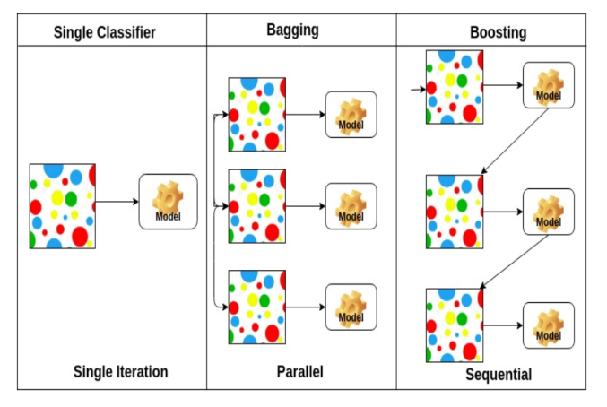
Creation of Prediction Model using ADABOOST Classifier
The Model is using ADABOOST classifier and UCL’s Parkinson dataset which has 23 attributes.
In this model, the value of status of Parkinson disease is predicted the by decision tree considering all critical values of every attribute and this is implemented inside the ADABOOST Classifier.
For example: Critical Value for PPE: 0.104
if >0.104 → check MDVP_Jitter
If <=0.104 → Healthy
4. Model get trained by using testing data set which is 20 % of original dataset.

Slide 8
Problem Formulation
Need of This project:
Parkinson's disease (PD) is a neurodegenerative disorder that affects predominately dopamine-producing (“dopaminergic”) neurons in a specific area of the brain called substantia nigra.
Since a vast majority of population suffers from this disease and faces consequences, henceforth it is very essential to find ways to predict as to what extent a person is suffering from Parkinson’s disease.
As of now, there is no sure shot laboratory test so as to find if a person is having Parkinson’s or not. With the help of this software we can predict the result, keeping in mind the attribute compatibility of the dataset.
For a normal user it is difficult to analyze the raw data of Parkinson’s with different attributes. Our software helps analyze these attributes and give a correct result prediction according to the dataset given.
This project also provides the user a friendly GUI interface because it gives the user a rich experience.

Slide 9
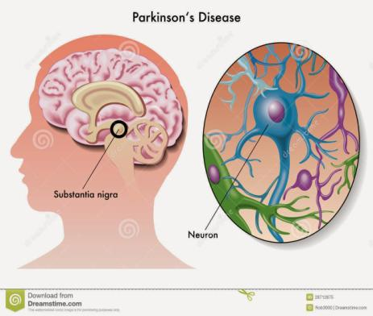
OBJECTIVES
The objective is to create an application based interface that visualizes the prediction of patients in the UCI Dataset
This software predicts the result with accuracy which depends on the number of entries of patient present in the dataset.
Till now there is no kind of medical test available for conclusive evidence of Parkinson disease so this software will be very helpful in medical infrastructure.

Slide 10
Project Model Flow:
Detailed study of the UCI Machine Repository’s Parkinson dataset will be done.
Identification of final parameters to be used for prediction will be done.
Installation of Python IDLE’S and required libraries will be done.
AdaBoost Classifier will be used along with weka for making a model.
The UCI dataset will be bifurcated into training set and testing set.
A model will be created in Python which will use the AdaBoost classifier to make predictions. The model will be trained using our training data set.
A python based application GUI interface will be made to display patient’s data and visualize it.
The trained model will be deployed within the GUI code and it will now be used to predict Parkinson status for the testing dataset.
The GUI code is improved in terms of presentability, beautification and optimization.

Slide 11
Attribute Tree Hierarchy:
The ADABOOST classifier boosts the classification on the basis of this attribute tree hierarchy:

Slide 12
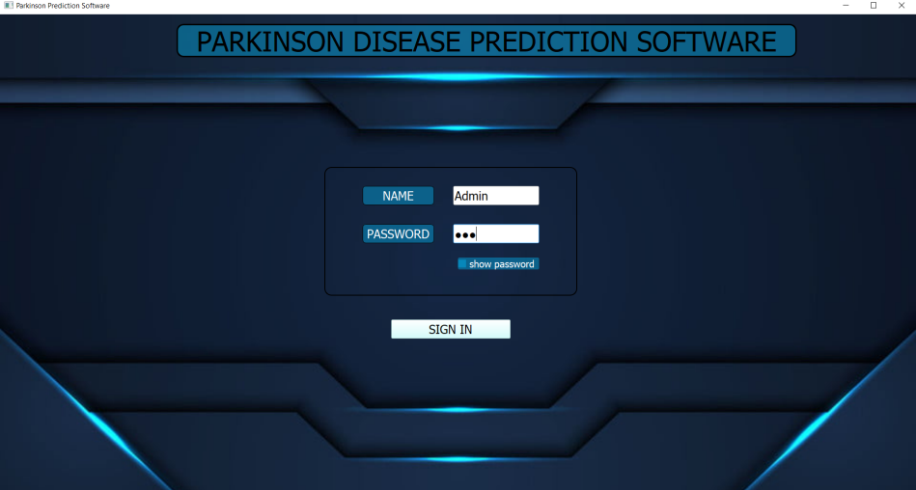
Results and Outputs

Slide 13
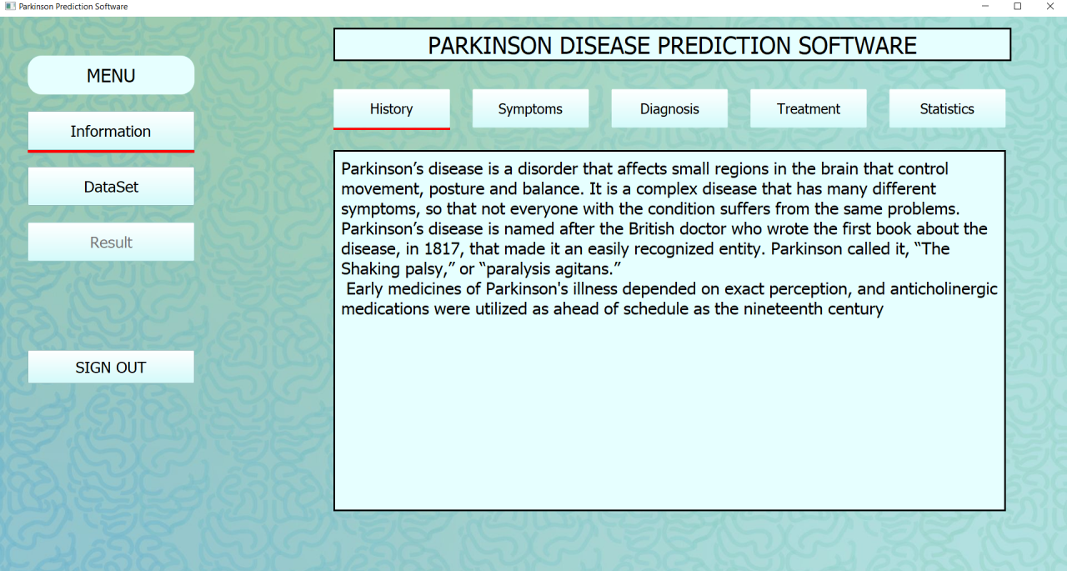

Slide 14
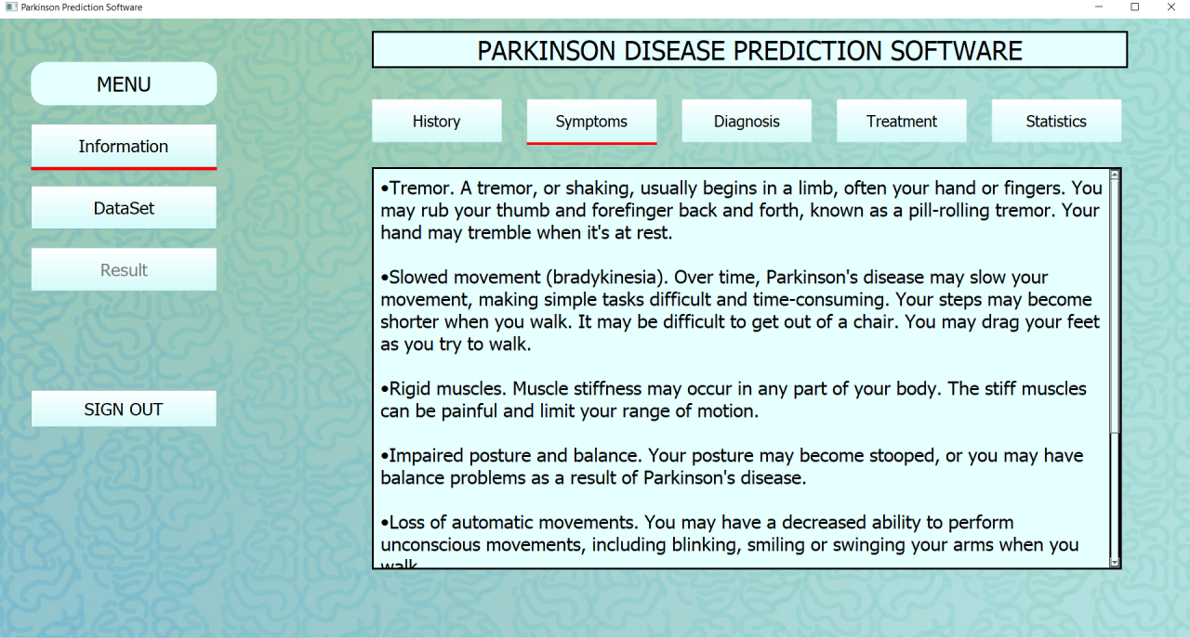

Slide 15
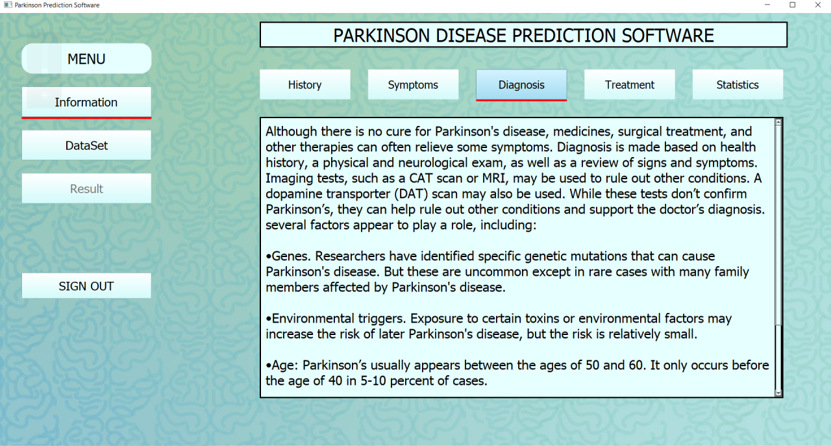

Slide 16
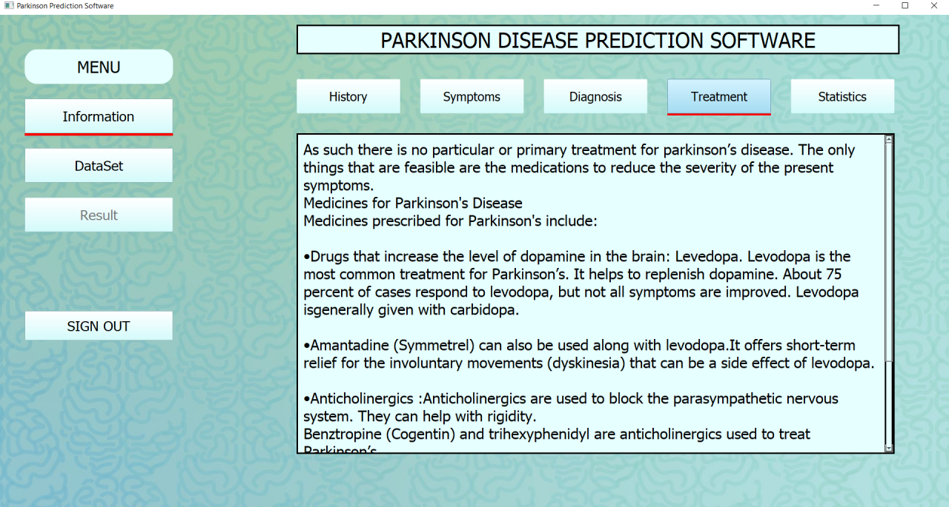

Slide 17
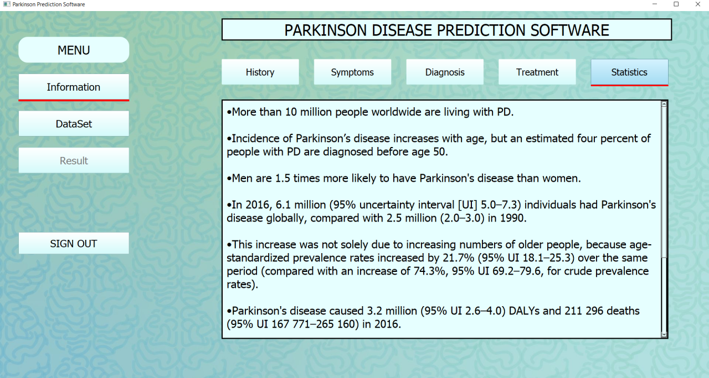

Slide 18
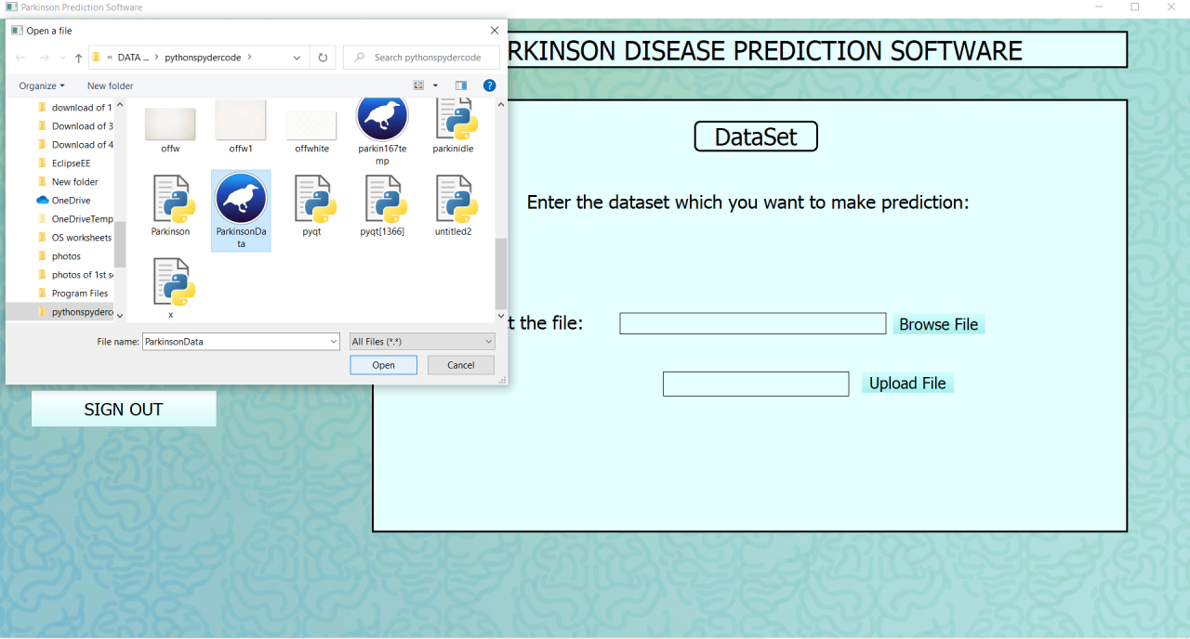

Slide 19
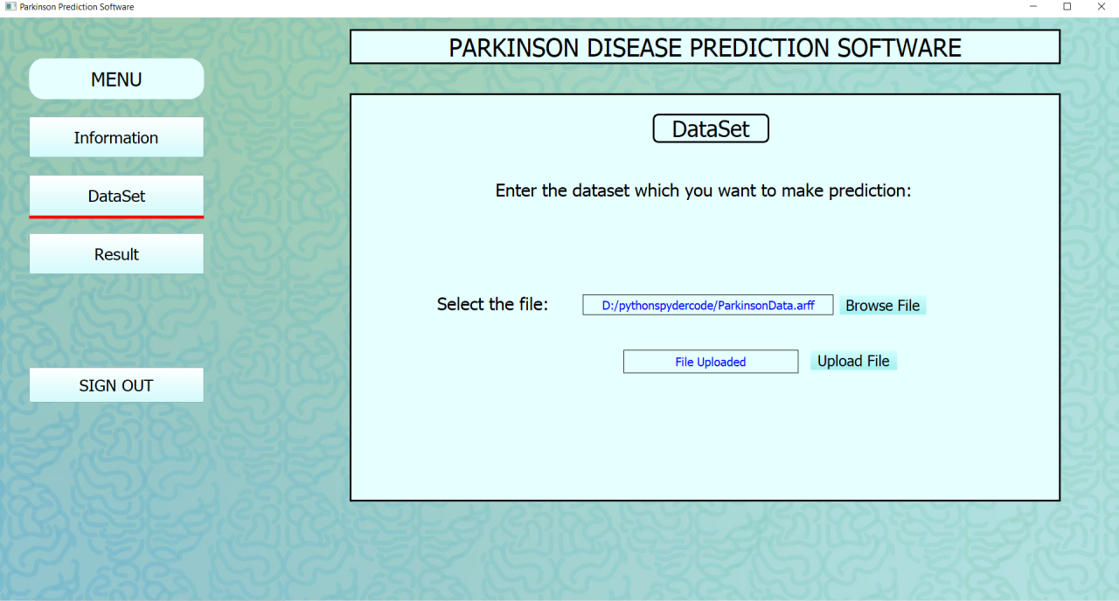

Slide 20
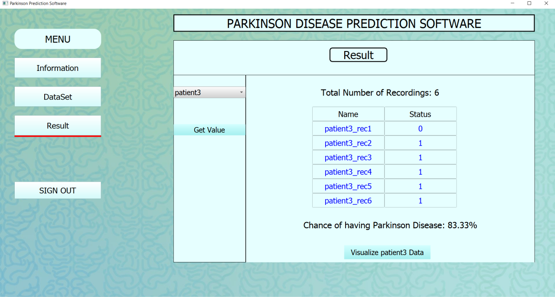

Slide 21
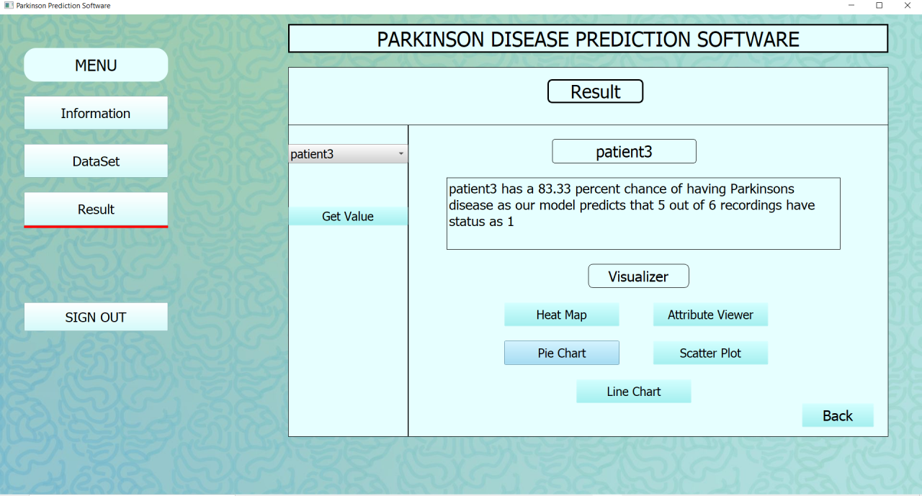

Slide 22
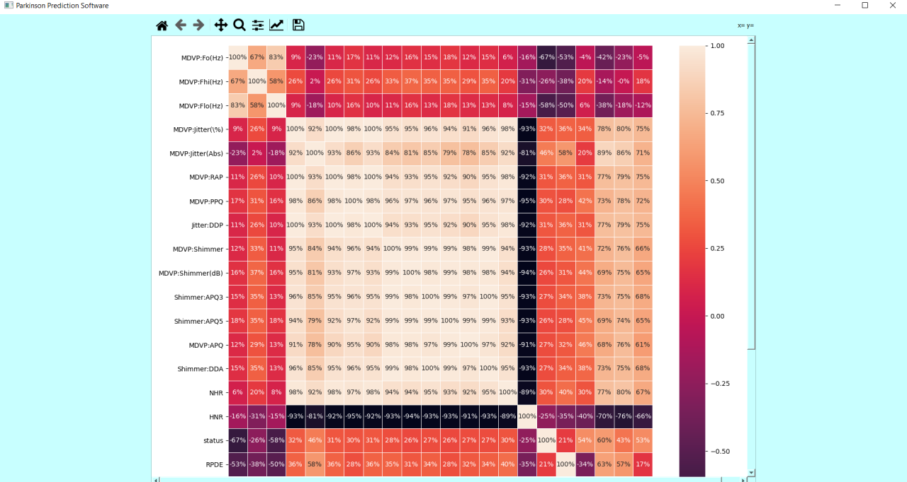

Slide 23
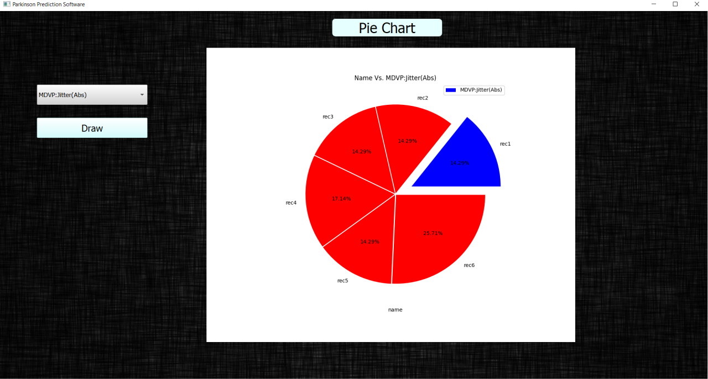

Slide 24
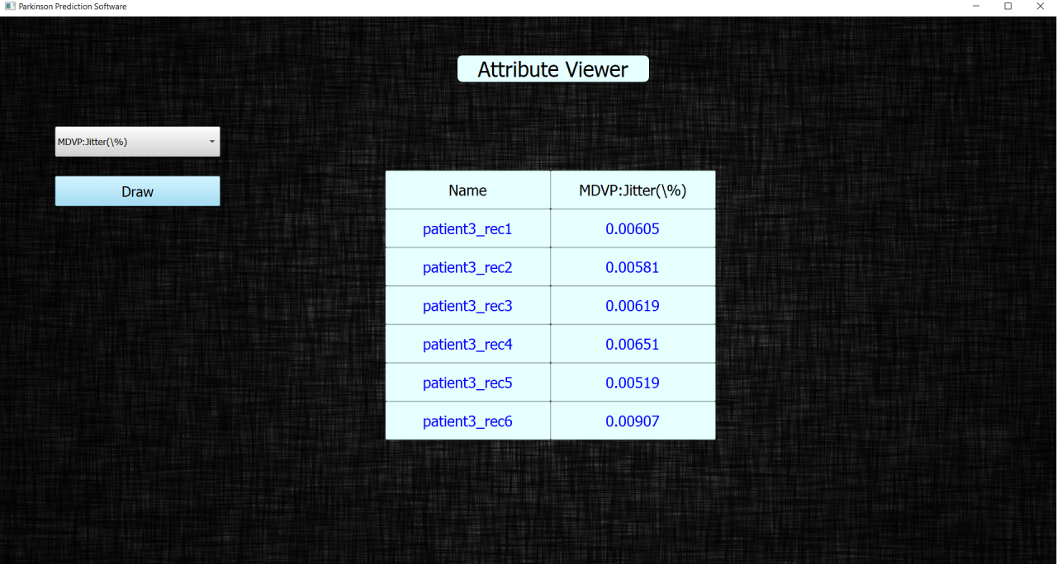

Slide 25
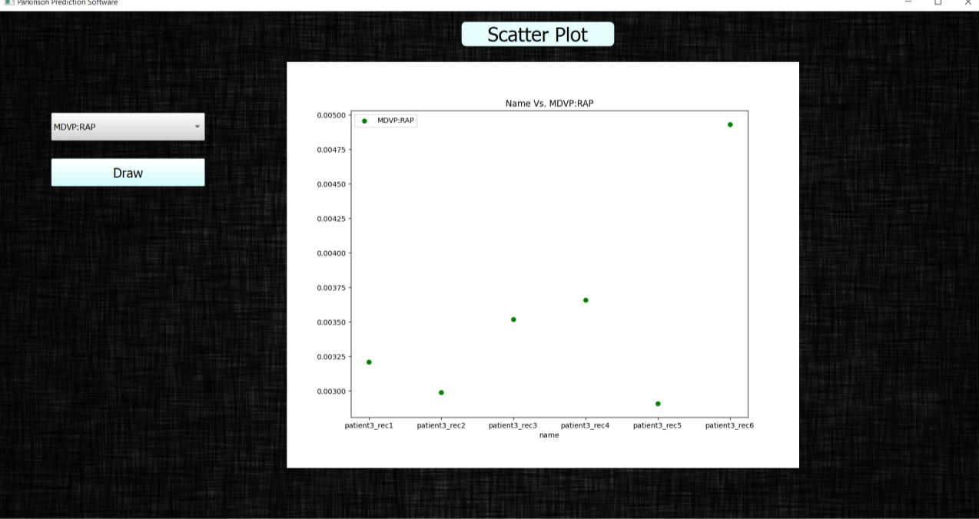

Slide 26
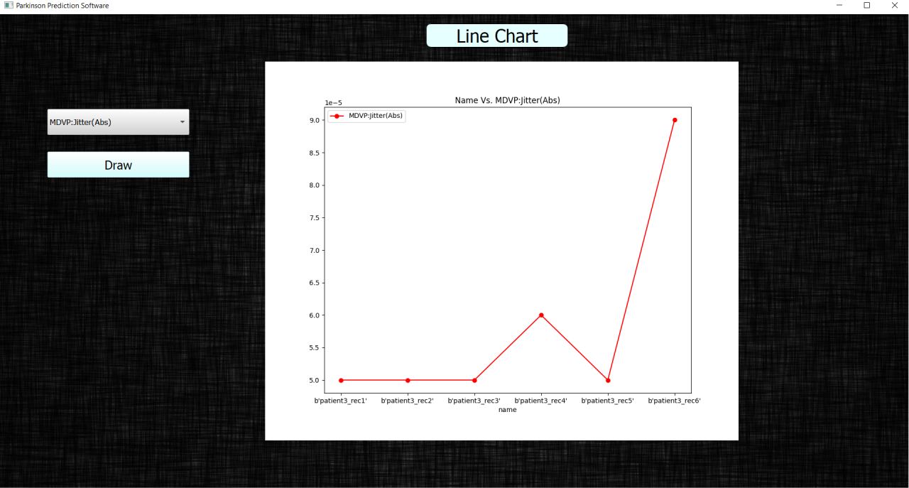

Slide 27
CONCLUSION
Parkinson’s disease prediction software is a desktop based GUI application which is making use of a prediction model based on ADABOOST classifier. It is predicting the result of Parkinson’s disease using ADABOOST Classifier according to the critical values.
PDPS is embedded with graphical user interface which will provide a user friendly environment and help them to interpret the data in a easy manner with the help some charts like scatterplot, pie chart, line chart etc.
The dataset being input in the PDPS needs to be concurrent with attributes as given in the UCI Machine repository dataset on Parkinson’s patients.

Slide 28
Future Scope
Advancement in the software: the model can be modified to predict the status of Parkinson disease on a real time basis with the help of medical instruments which can collect valid data for 23 attributes.
New modifications and enhancements can be done in this project with respect to newer but unstable versions of Adaboost classifier.
The project can also be enhanced to convert it from a desktop based application to a web based application so that it can work as a distributed system and can be more feasible to a varying audience.
Operating system based conversion can also be done so as to make the software runnable on different operating systems such as Mac OS.
Stronger cross validation using more cross validators can be done on the prediction model.

Slide 29
References
UCI dataset: https://archive.ics.uci.edu/ml/machine-learning-databases/parkinsons/
Parkinson’s Brain Disease Prediction Using Big Data Analytics” by N. Shamli and B. Sathiyabhama
http://www.mecs-press.org/ijitcs/ijitcs-v8-n6/IJITCS-V8-N6-10.pdf
Symptom Analysis of Parkinson Disease using SVM-SMO and Ada-Boost Classifiers by Muhtasim Billah
https://core.ac.uk/download/pdf/61803688.pdf
Parkinson Australia: http://www.parkinsons.org.au/about-ps/about-pd.htm
UCI Parkinson repository dataset: https://archive.ics.uci.edu/ml/machine-learning-databases/parkinsons/
An Expert Diagnosis System for Parkinson Disease Based on Genetic Algorithm-Wavelet Kernel-Extreme Learning Machine:
https://www.ncbi.nlm.nih.gov/pmc/articles/PMC4871978/#:~:text=The%20main%20symptoms%20of%20PD,many%20patients%20and%20their%20families

Slide 30
History of Parkinson’s disease: https://link.springer.com/article/10.1007/s00415-006-7002-7
Anchana Khemphila and Veera Boonjing. ―Parkinson Disease Classification using Neural Network and Feature selection‖.
P. F. Guo, P. Bhattacharya, and N. Kharma, “Advances in detecting Parkinson’s disease.” In Medical Biometrics. Springer Berlin Heidelberg. pp. 306—314, 2010

